Slide 1
Justin Pan Demo Map
Created by React, TypeScript, and ESRI JavaScript API
Merged multiple ESRI JavaScript API samples into one web GIS map
Original samples from ESRI are JavaScript, not React/TypeScript
More functions / widgets can be added in the same way

Slide 2
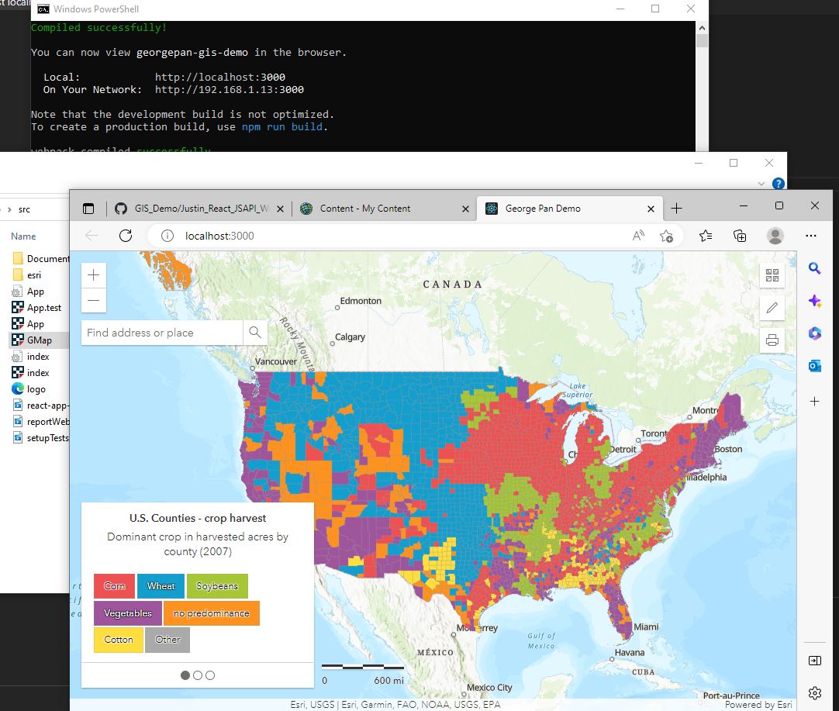
NPM Start
React app structure

Slide 3
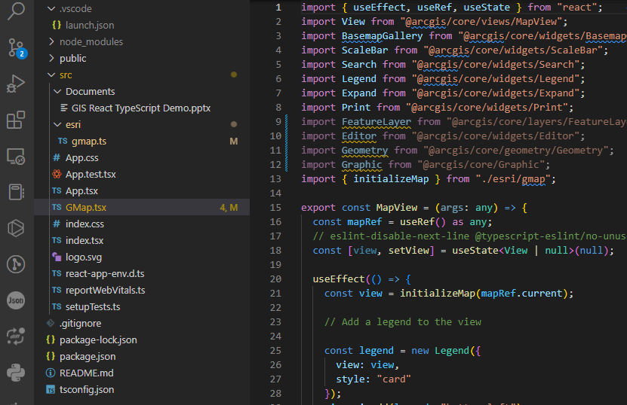
React Hooks
TypeScript files

Slide 4
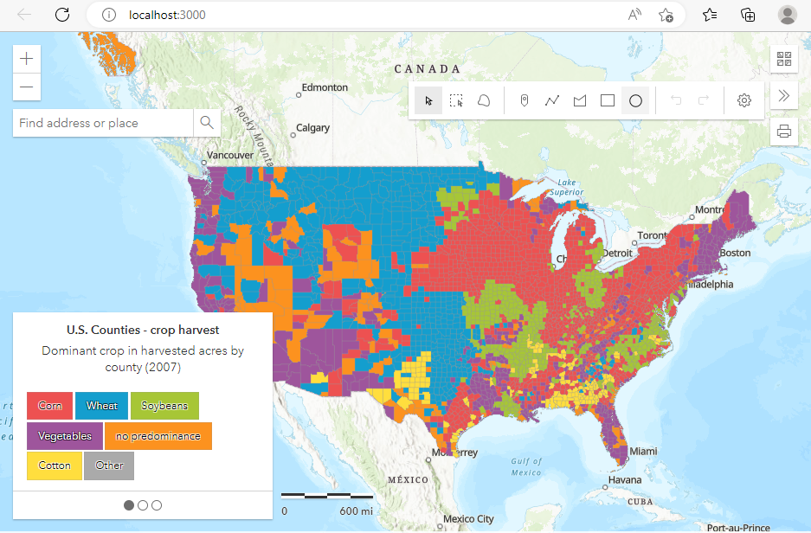
Sketch

Slide 5
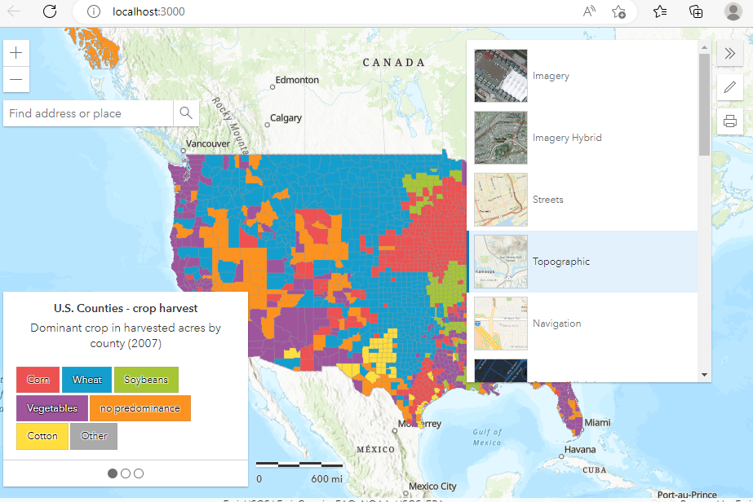
Base Maps

Slide 6
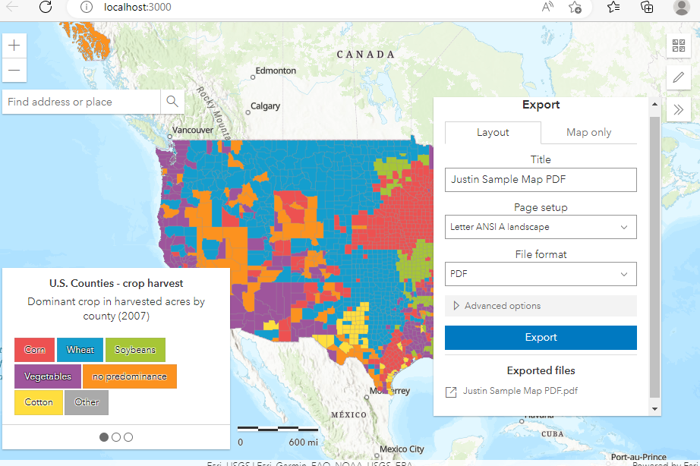
Print Maps

Slide 7
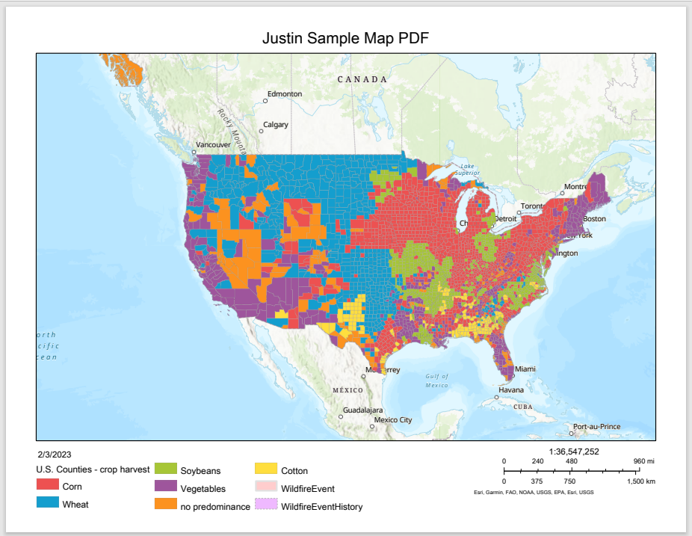

Slide 8
